Slide 1











Beyond the basics
Take your Biml skills to the next level

Slide 2






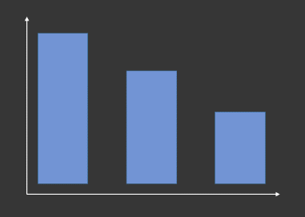

about
SQLKover.com
@Ko_Ver
Notes:
Introduce yourself, but keep it short. Mention your years of experience and how they can reach you.

Slide 3
agenda
recap
reusing code
annotations
troubleshooting

Slide 4
recap!
quick refresh of Biml power

Slide 5
DEMO
Notes:
Create staging packages to transfer AW 2017 to a staging environment.

Slide 6

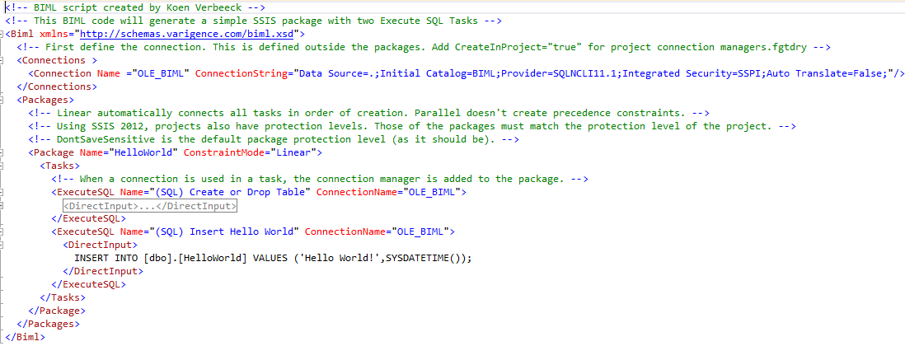
what is Biml?
Notes:
started as a project at MS: http://vulcan.codeplex.com/
developer left to found company Varigence http://www.varigence.com/
took the idea (not the code) and developed BIML
Biml is a markup language and compiler
translates metadata into business intelligence solutions for SQL Server
supports SSIS and SSAS
Varigence made part of Biml available as open source

Slide 7
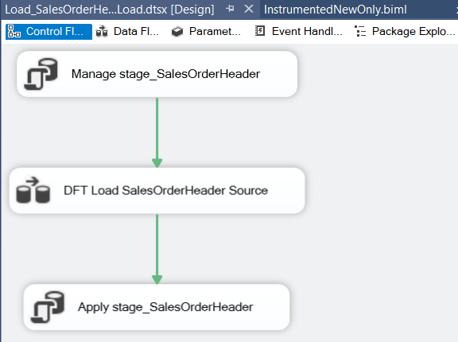
what is Biml?
Notes:
Using an XML dialect, the Biml compiler generates SSIS packages. The XML of Biml is considerably easier to read than the one used in the actual SSIS packages.

Slide 8
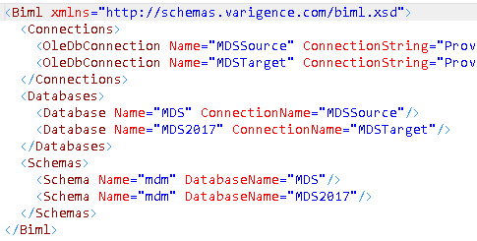
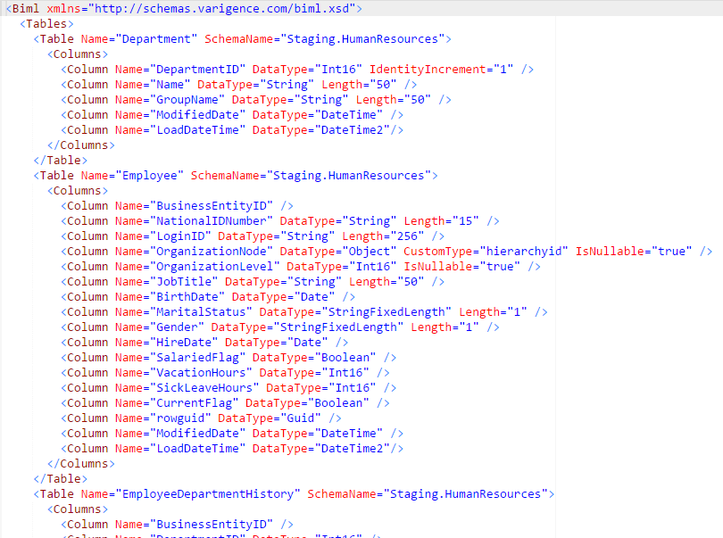
but also…
Notes:
With Biml you can also generate/specify relational metadata.

Slide 9
code reuse
work smarter, not harder

Slide 10
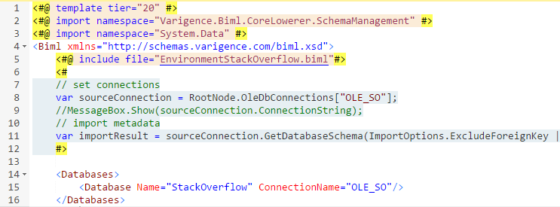
reusing code
Notes:
Include file. Just include the contents of the file directly into the Biml code. Make sure your tags match.
You can also include other types of files, such as .cs or .sql.
Demo: behaves wonky when the template tiers are left out.
Good use case would be to control the logging framework.

Slide 11
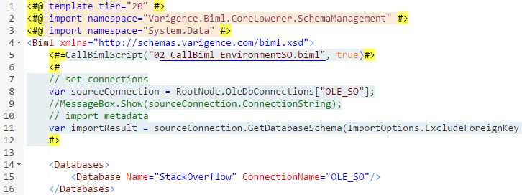
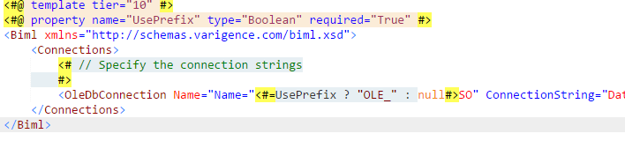
reusing code
Notes:
CallBiml works like IncludeFile, except that you can pass parameters to change behavior. You have the caller and the callee. You cannot preview the callee.

Slide 12
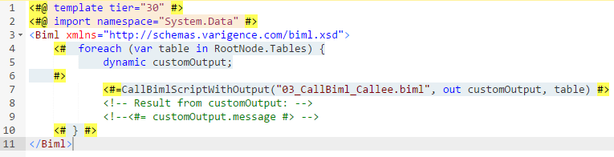
reusing code
Notes:
With CallBimlScriptWithOutput you can specify output parameters.

Slide 13
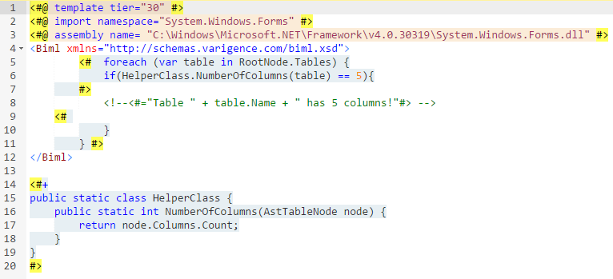
reusing code
13
Notes:
inline

Slide 14
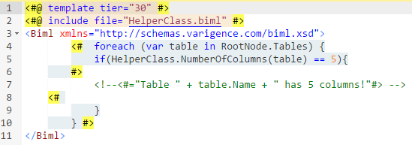
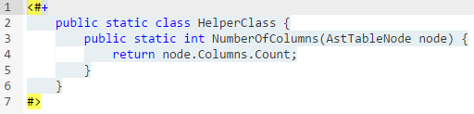
reusing code
Notes:
inline

Slide 15
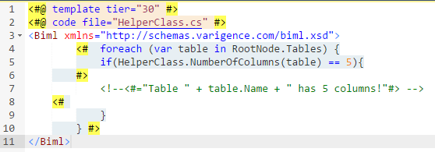
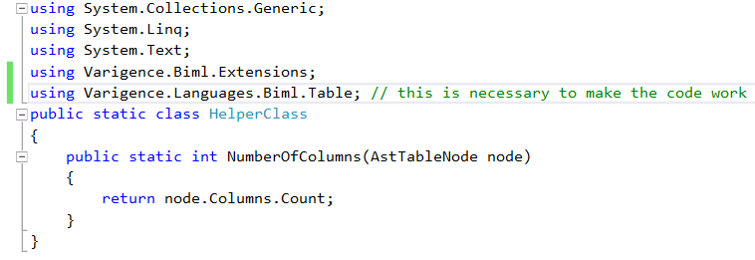
reusing code

Slide 16
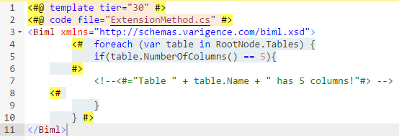
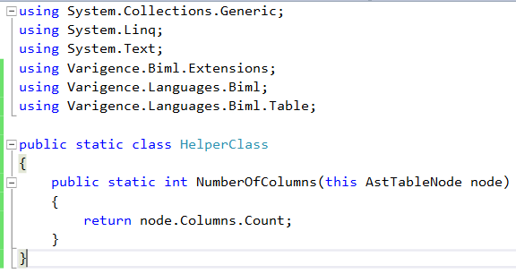
reusing code
Notes:
While using extension methods, you don’t have to type HelperClass in front of the function.

Slide 17
DEMO

Slide 18
annotations & frameworks
build out your toolbox

Slide 19

creating a framework
SSIS packages & relational objects
metadata
Biml framework

Slide 20
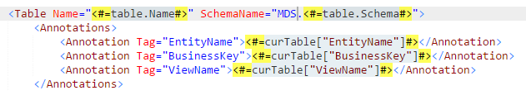
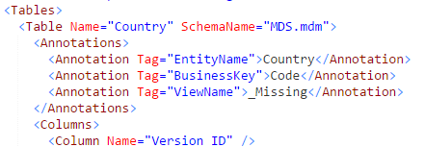
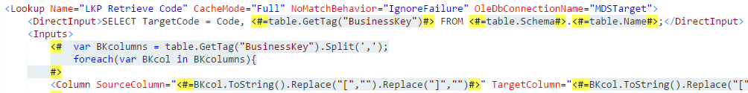
annotations
Notes:
Annotations are key-value pairs that allow you to bind metadata to objects. With this you can make your Biml more robust and dynamic. There are also object tags.

Slide 21
DEMO

Slide 22
troubleshooting
bang bang bang

Slide 23
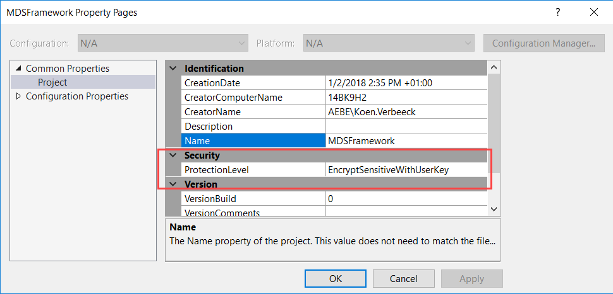
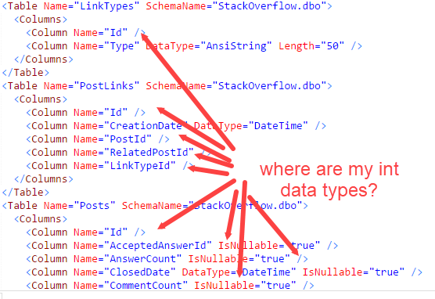
be aware of the defaults
Notes:
In a lot of cases, you don’t have to write Biml code to specify default properties. This means you have to know what the default properties are.

Slide 24
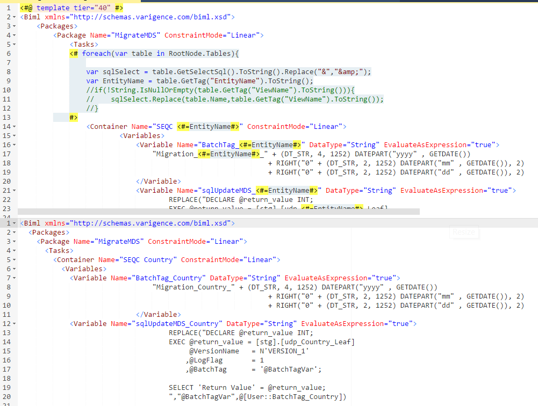
use the preview pane
Notes:
successful compilation doesn’t mean SSIS packages can be generated!!!

Slide 25
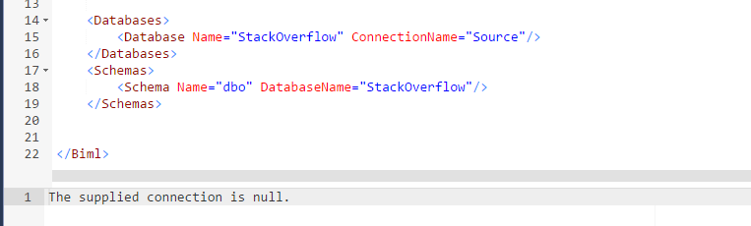
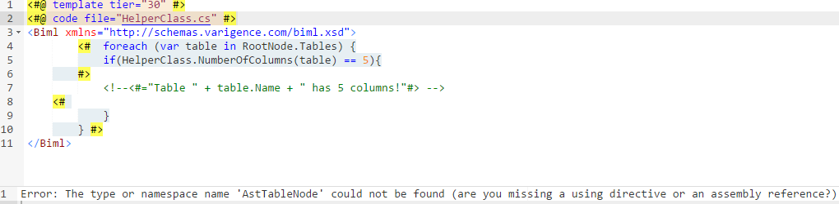
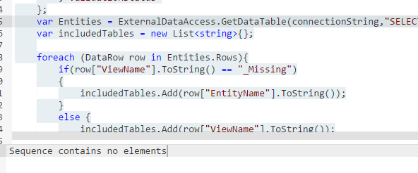
use the preview pane
Notes:
error messages, typically C# errors

Slide 26
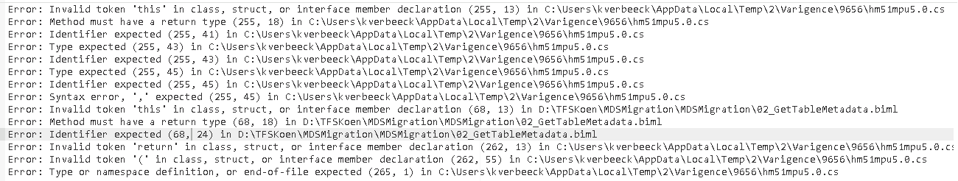
use the preview pane
Notes:
error messages, typically C# errors. This one pops up when you have a } too many or too few in your code.

Slide 27
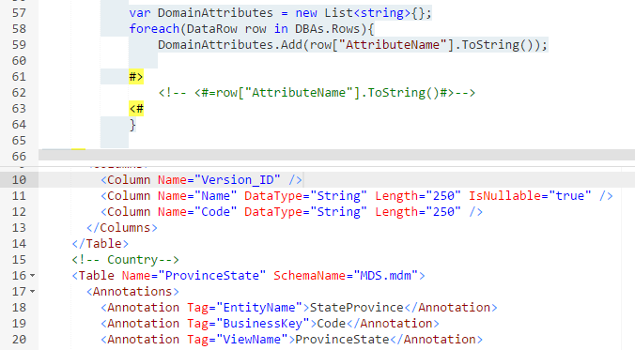
write comments to the preview pane
Notes:
successful compilation doesn’t mean SSIS packages can be generated!!!

Slide 28


Slide 29

ye olde message box
Notes:
Quick & dirty debugging.

Slide 30

logging
Notes:
You can log actions of the Biml compiler to a log file, or write your own log messages.

Slide 31

throw an error

Slide 32
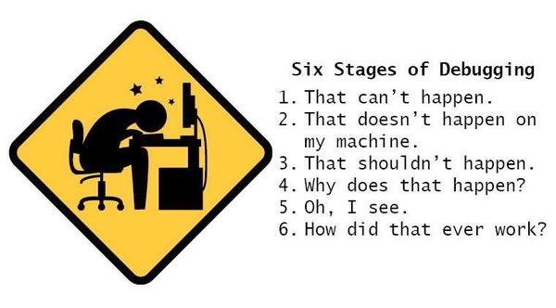
debug utilities

Slide 33

documentation
Notes:
Mostly a BimlStudio feature. But you can write some code to parse the XML of the generated Biml and generate some HTML docs (described in the book). If anyone is feeling lucky…

Slide 34
DEMO

Slide 35
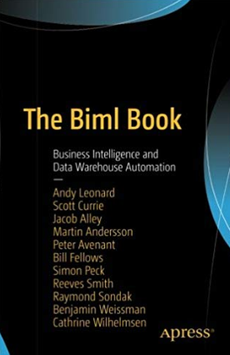
resources
Biml Tutorial @MSSQLTips
Documentation
BimlScript
Cathrine Wilhelmsen
Ben Weissman
Biml Toolbelt
https://github.com/KoenVerbeeck/DataMindsBiml

Slide 36


In appreciation of our sponsors

Slide 37


